Slide 1
Photomicrographs of Plant foods
Bean: Pinto
Permission to reproduce original photomicrographs used to make this collection may be obtained from
Dr. David O. Norris at
david.norris@colorado.edu

Slide 2
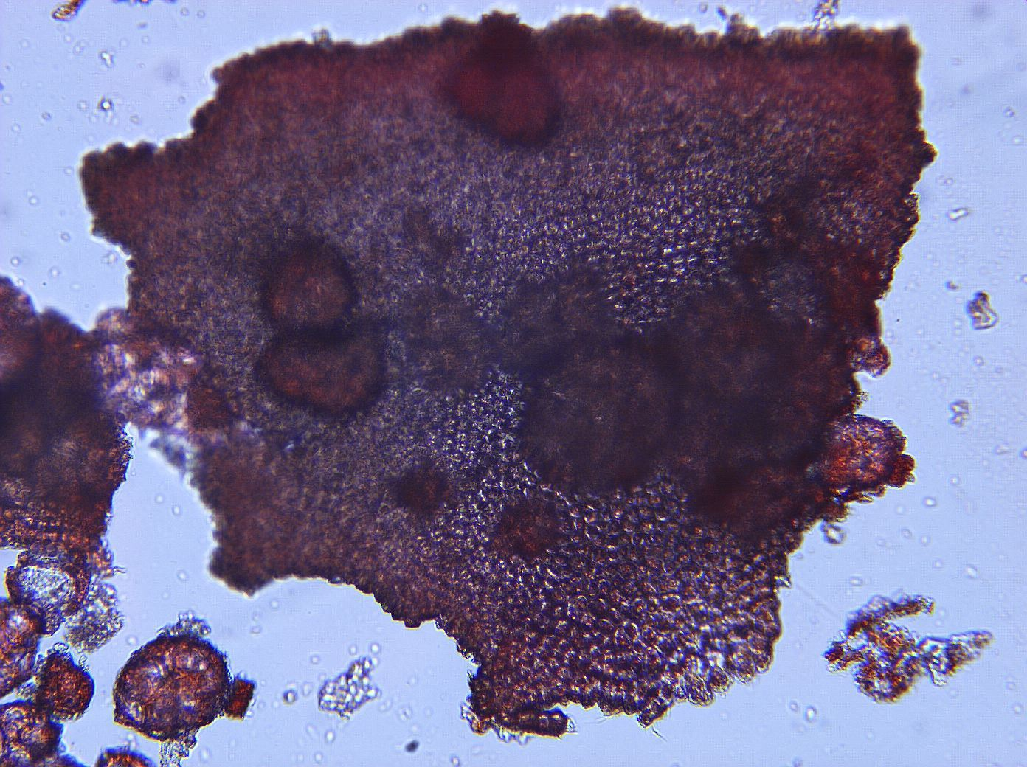
Notes:
72. Phaseolus vulgaris L. Bean, pinto. Seed coat (testa), 10X.

Slide 3
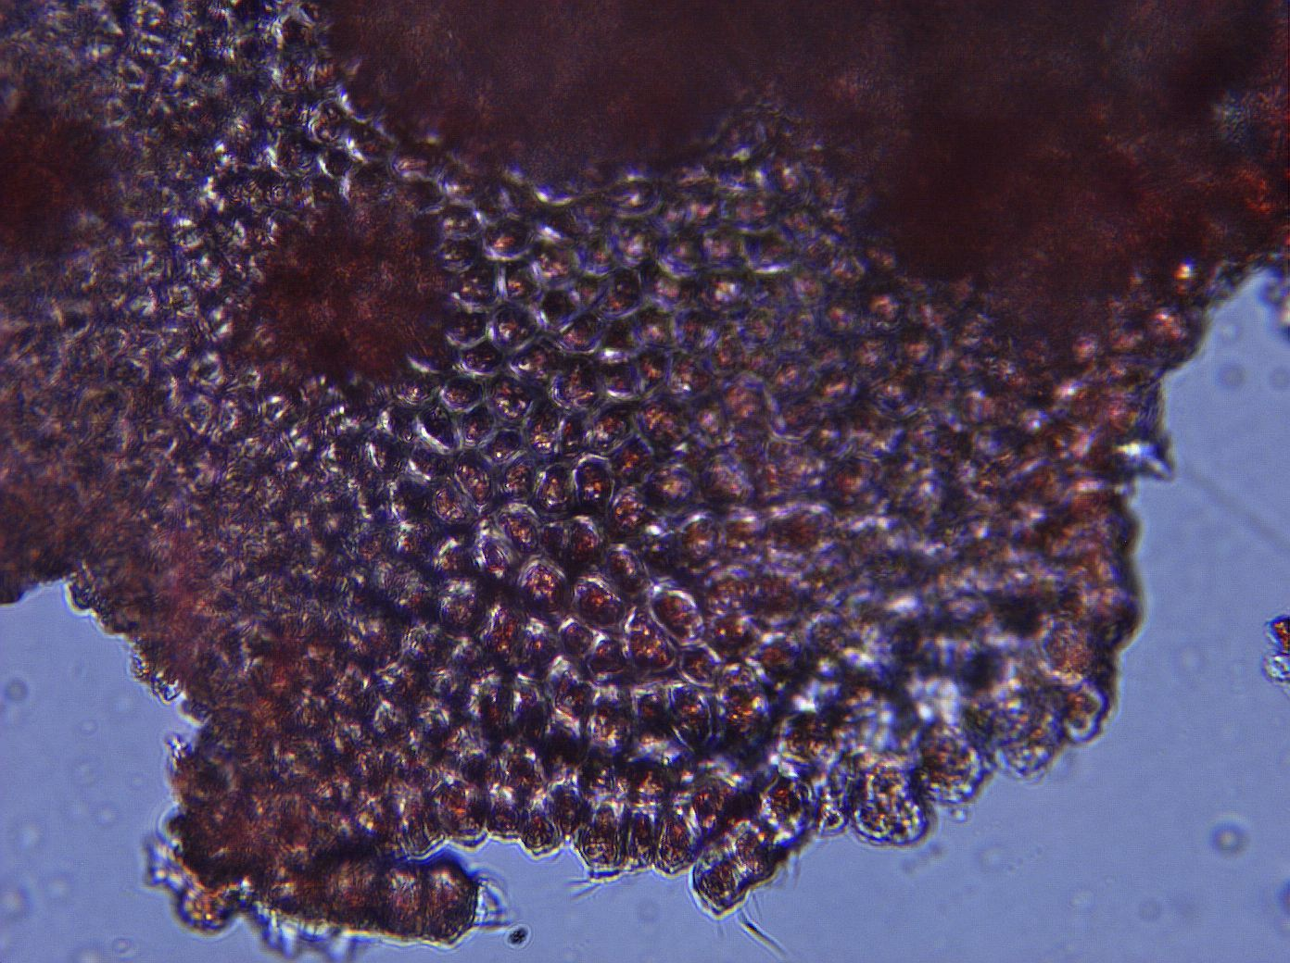
Notes:
73. Bean, pinto. Seed coat, 40X

Slide 4
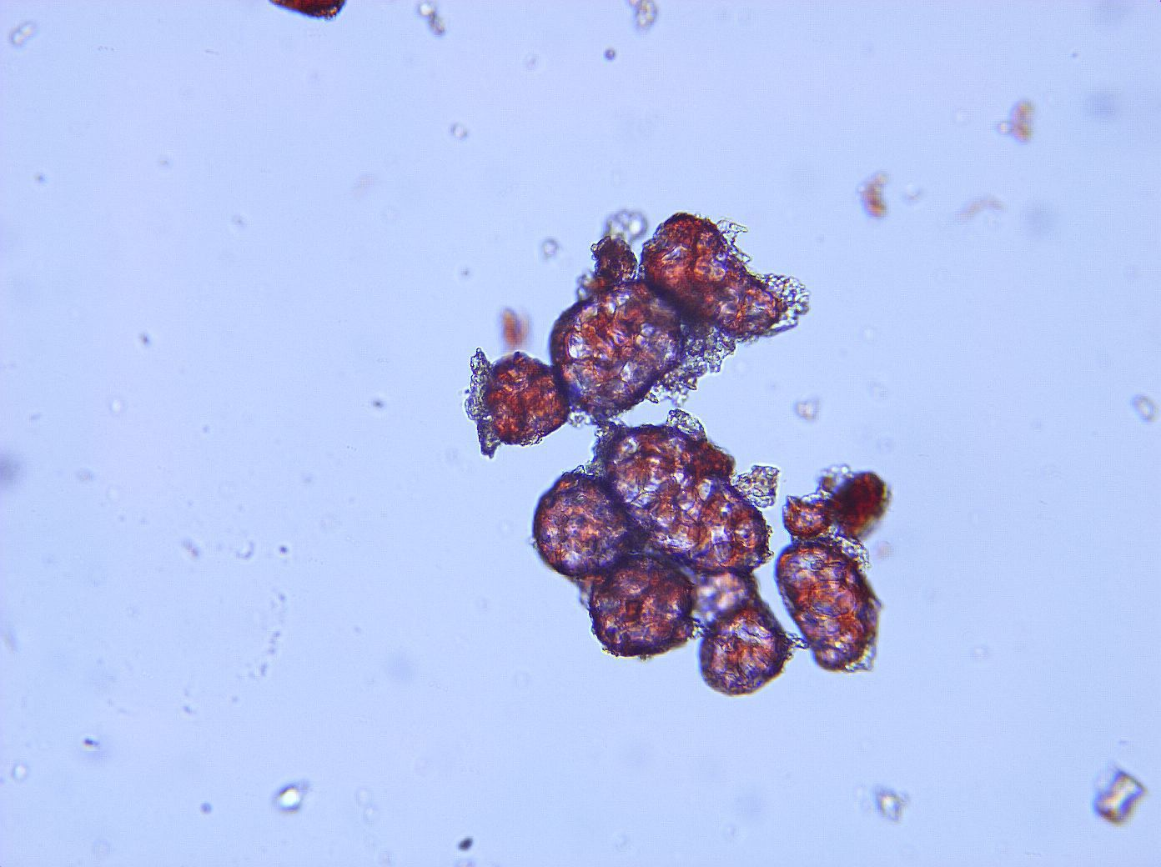
Notes:
74. Bean, pinto. Pulp parenchymal cells, 10X.

Slide 5
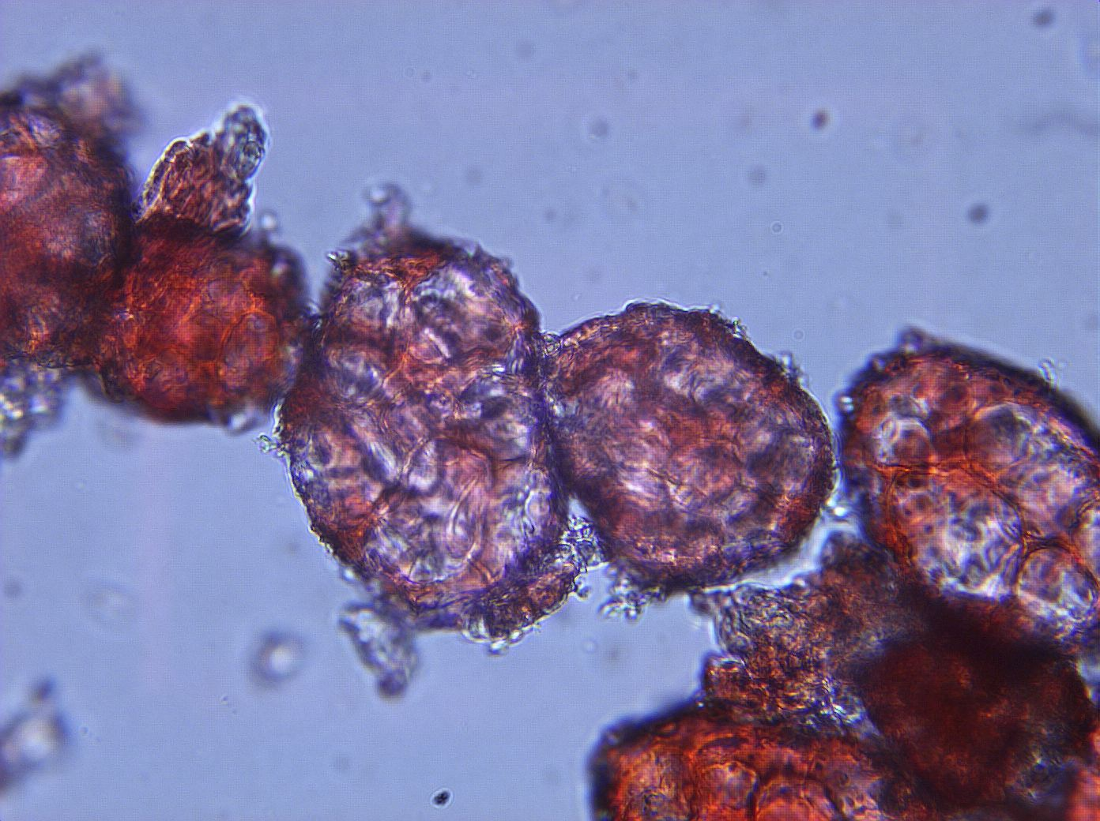
Notes:
75. Bean, pinto. Pulp parenchymal cells, 25X.

